Slide 1
Population Coding of Motion in the Retina
Colleen Rhoades
December 5, 2014

Slide 6
Background
Parasol largely project to magnocellular pathway of LGN while midgets largely project to the parvocellular pathway of the LGN (Perry 1984)
People argue the pathways are separate all the way through visual processing (Maunsell 1990)
Notes:
image from Shabana 2003

Slide 7
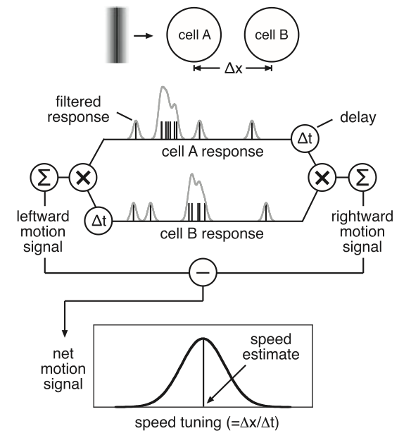
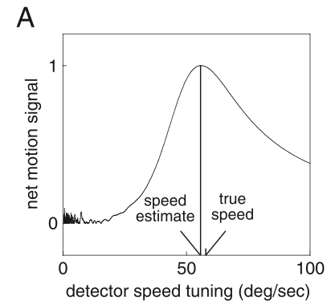
Algorithm
Previous Results

Slide 8
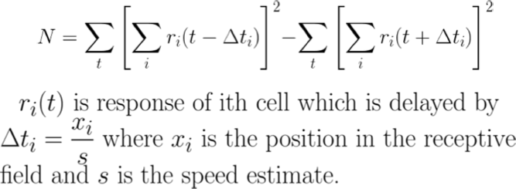
New Implementation

Slide 9
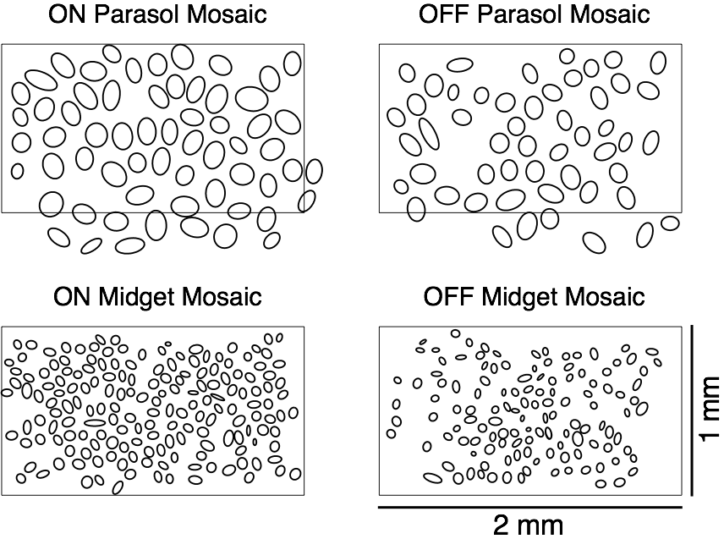

Slide 10
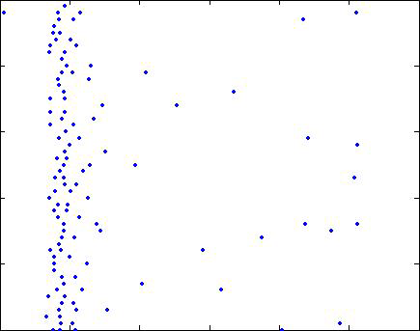
Recoding Stable across 50 Trials
Stability of Firing Of Each Cell Across All Trials
Trial Number
Time

Slide 11
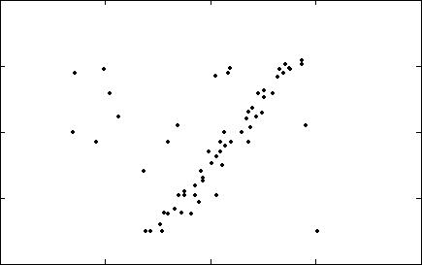
Cells Response All Bar Passes Over Their Position
All Cells Responses Plotting Over Many Trials
Cell Centroid Distance from Ref.
Time

Slide 12
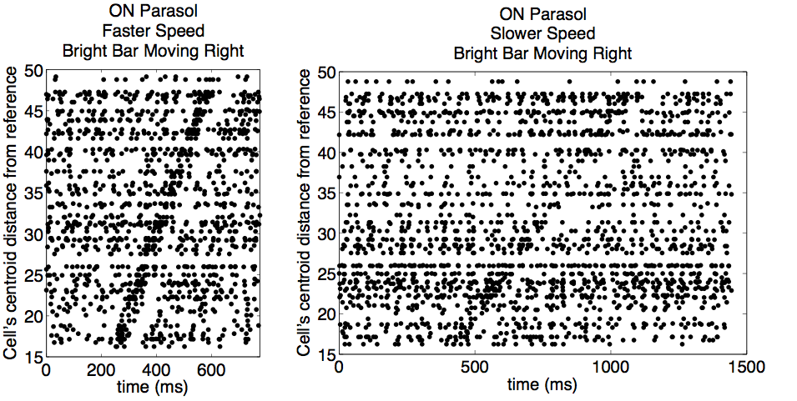
Different Speeds Have Different Rasters

Slide 13
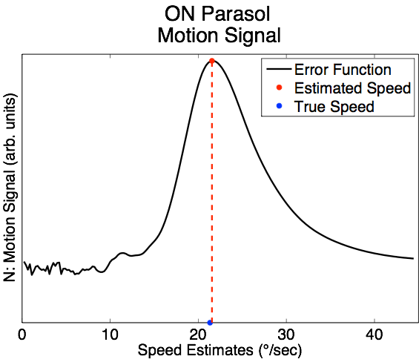
Maximally Align Spike Trains

Slide 14
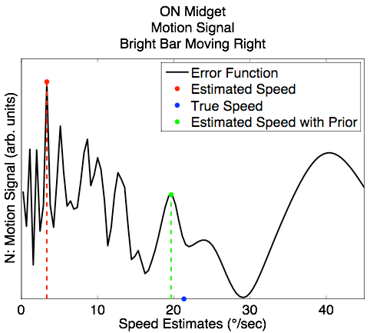
Using Priors For Speed Estimate

Slide 15
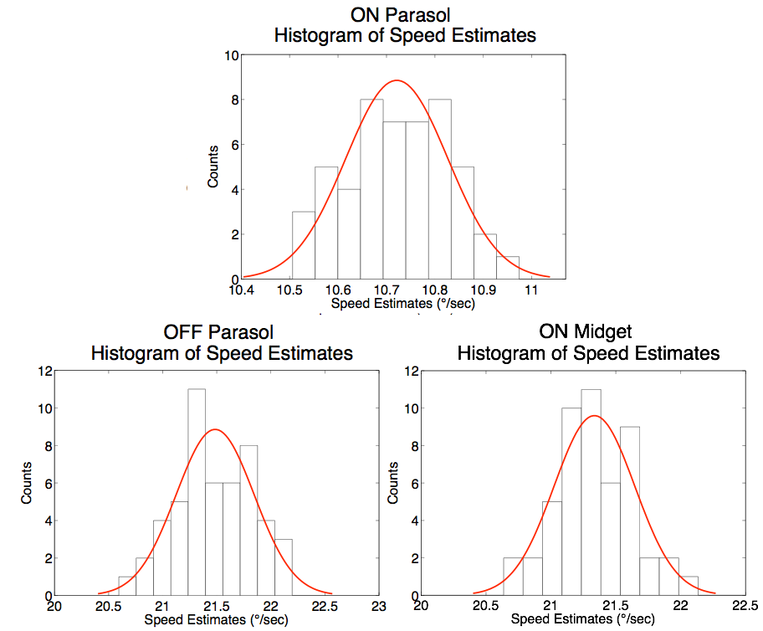

Slide 16
Factors that affect motion estimate
Stimulus contrast
Stimulus direction
Stimulus speed
Stimulus width
Tissue sample
Gaussian filter width

Slide 17
Factors that affect motion estimate
Grouping population signals
Unequal firing rates
Incomplete mosaics
Spike sorting

Slide 18
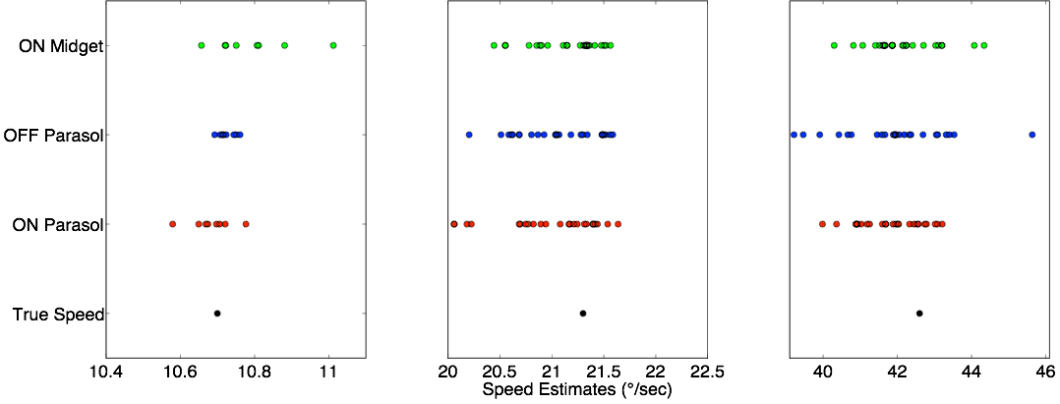
Mean Speed Estimate Per Run

Slide 19
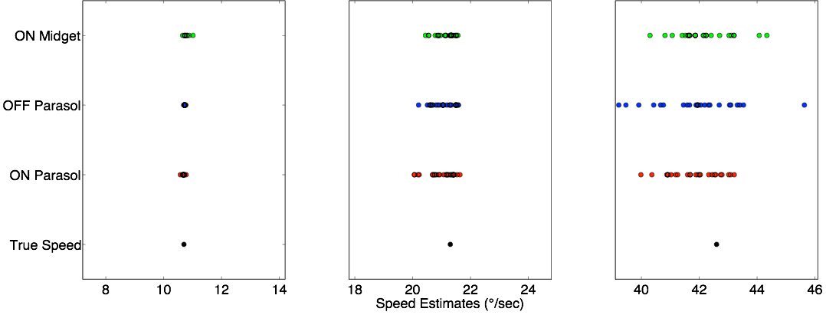
Speed Estimates on the Same Scale

Slide 20
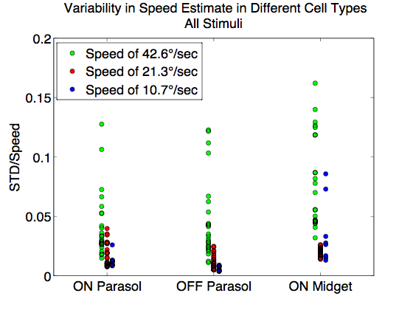
Speed

Slide 21
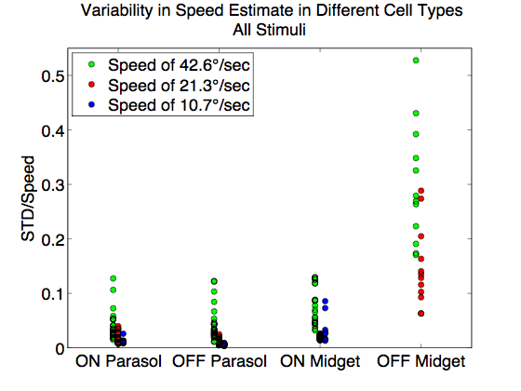
OFF Midgets

Slide 22
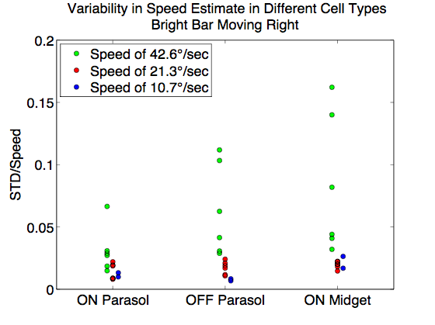
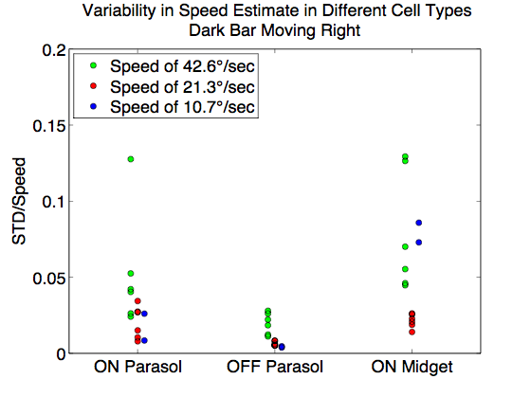
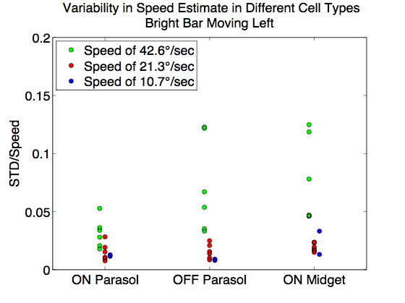
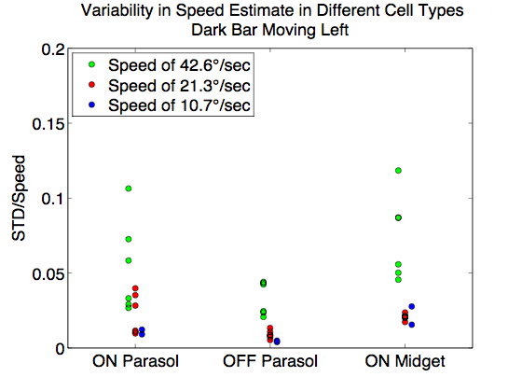
Speed Broken Down by Stimulus Type

Slide 23
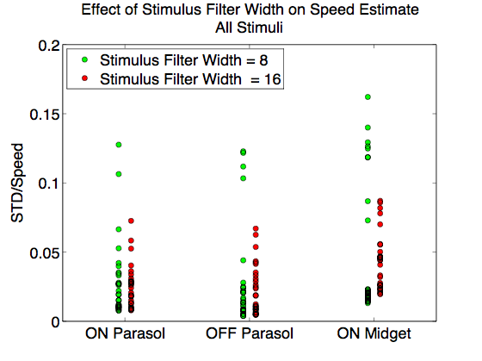
Stimulus Width

Slide 24
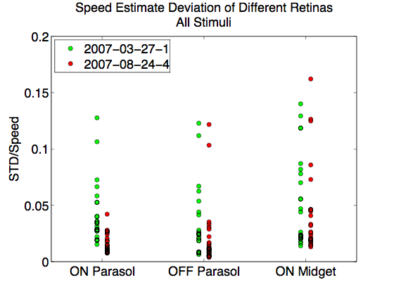
Tissue Sample

Slide 25
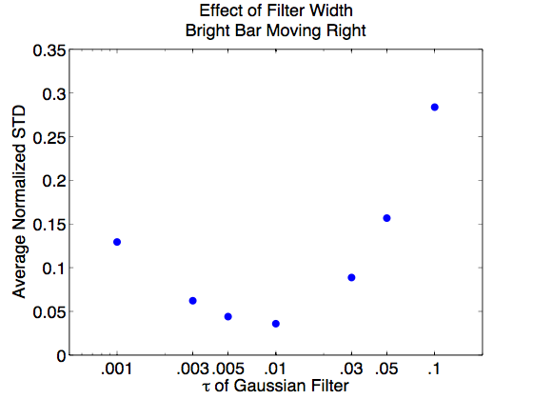
Gaussian Filter Width
w = w∞ + α/(sc)
where the optimal filter width depends on the speed, contrast, and asymptotic filter width for high speed/high contrast (Chichilnisky and Kalmar, 2003)

Slide 26
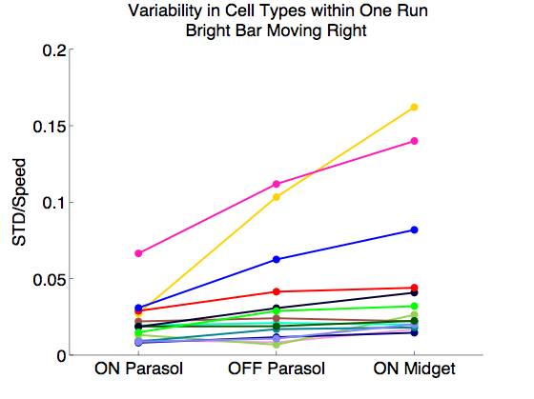
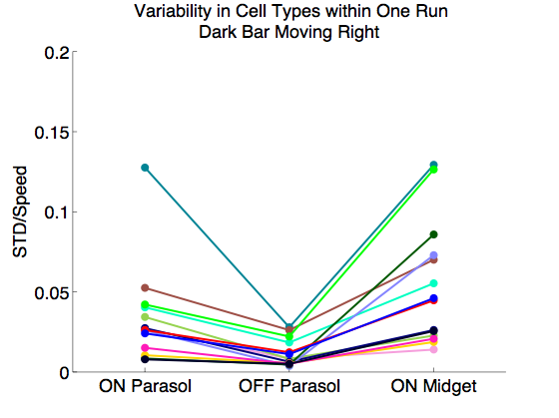
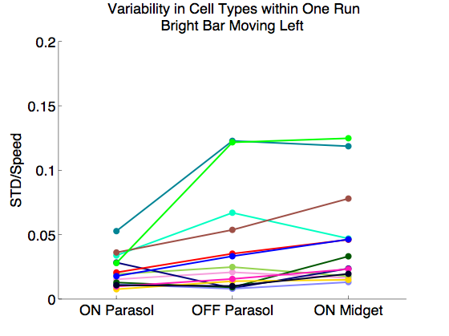
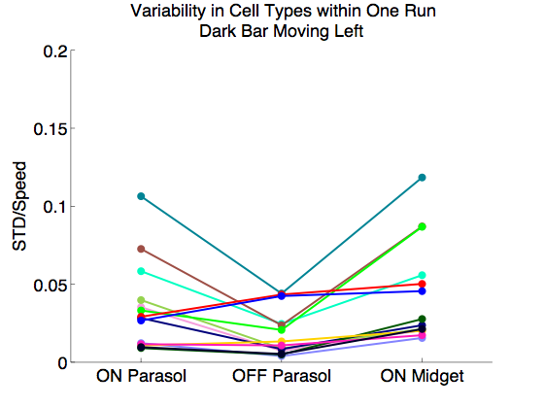
Do certain runs have higher variability across all cell types?

Slide 27
Future
For this model:
Take a closer look at OFF midget cells
Down sample to account for firing rate differences
Down sample to account for incomplete mosaics
Verify spike sorting
Big Picture:
Is the brain actually performing these computations?
What other models should be considered?
How do cortical neurons process this information?
What about accelerating motion?

Slide 28
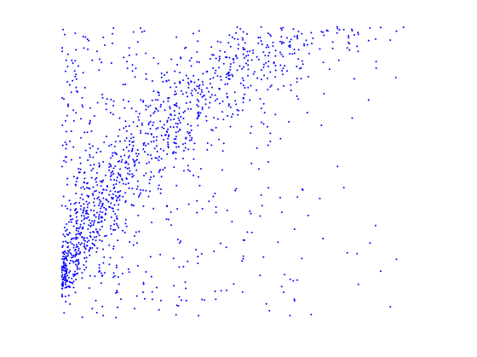
Acceleration
Cell centroid distance from ref.
Time

